Slide 1
Beneficial Owner Reporting for Salons
Presented by
Chris Wittich, MBT, CPA

Slide 2
Disclaimers
The information contained herein should not be construed as legal, accounting, or tax advice. The commentaries provided are the opinions of Boyum Barenscheer PLLP and are for informational purposes only. While the information is deemed reliable, Boyum Barenscheer cannot guarantee its accuracy, completeness, or suitability for any purpose and makes no warranties with regard to the results to be obtained from its use, or whether any expressed course of events will actually occur. The user should contact his or her Boyum Barenscheer or other tax professional prior to taking any action to ensure the user's unique facts and circumstances are considered prior to making any decisions.

Slide 3
Agenda
Corporate Transparency Act
Who is required to file?
When is it required to be filed?
What information is required on the report?
What are the penalties?
How do you file BOI?
Examples + Closing thoughts + Q&A

Slide 4
Corporate Transparency Act
Congress passed the Corporate Transparency Act in 2021 as part of Bank Secrecy Act
Mandates that millions of entities report their beneficial ownership information to the Financial Crimes Enforcement Network (FinCEN)
FinCEN would use that information to improve transparency and tracking and enhance enforcement efforts for financial crimes
FinCEN estimates 32.6 million existing reporting companies
FinCEN estimates 5 million new reporting companies each year
2024 is the first year for the BOI reporting

Slide 5
Who is required to file?
All domestic and foreign entities that have filed formation or registration documents with a US State unless they meet an exception listed below
23 industry exceptions
Exempt – large operating entities
Exempt – publicly traded companies

Slide 6
Who is required to file?
23 industry exceptions
Securities reporting issuer
Governmental authority
Bank
Credit Union
Depository institution holding company
Money services business
Broker or dealer in securities
Securities exchange or clearing agency
Other exact act registered entity
Investment company or investment adviser
Venture capital fund adviser
Insurance company
State licensed insurance producer
Commodity exchange Act registered entity
Accounting firm
Public utility
Financial market utility
Pooled investment vehicle
Tax exempt entity
Entity assisting a tax exempt entity
Large operating company
Subsidiary of certain exempt entities
Inactive entity

Slide 7
Who is required to file?
Exempt – large operating entities that meet all 3 of these:
Employ more than 20 FTE in the US. This is the same definition as full time employee that was used for ERC purposes and for health insurance purposes. It requires an average of 30 hours per week to be considered full time employee.
Gross receipts or sales over $5M on the prior year’s tax return. This only includes US based gross receipts or sales.
Has a physical office in the US. Entity regularly conducts business at physical location either owned or leased and is not shared with any other entity.

Slide 8
When is it required to be filed?
Entities formed prior to 1-1-2024 have until 12-31-2024 to make their initial filing
Entities formed during 2024 have 90 days to complete their initial filing from the date of their initial formation
For 2025 the report will be required to be updated within 30 days of a change in the information
Change of address for a beneficial owner
New beneficial owner joins the company
Restructuring changes the beneficial owner

Slide 9
What information is required to be on the report?
Beneficial Owner is any individual who:
Directly or indirectly exercises substantial control over the company
OR
Owns/controls at least 25% of the ownership interests
Business can have multiple beneficial owners in each category. Could have multiple officers who exercise substantial control. Could have multiple people that own at least 25% of the ownership interest.

Slide 10
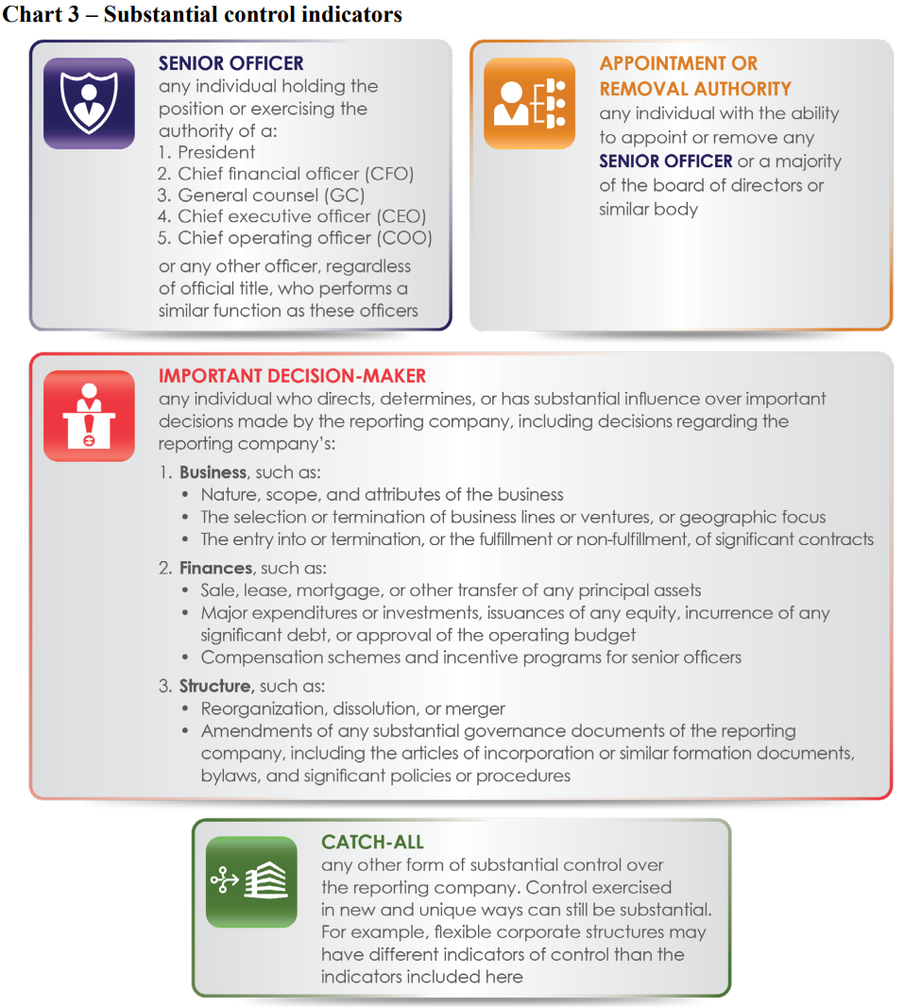
What information is required to be on the report?

Slide 11
What information is required to be on the report?
Business reporting:
Full legal name of the reporting company and any trade or DBA names
Address of principal place of business
State of formation
IRS EIN

Slide 12
What information is required to be on the report?
Individual reporting:
Full legal name
Birthdate
Current Address
Unique identifying number and issuing jurisdiction and image of the document (US passport, State drivers license, identification document issued by state)
Alternatively a FinCEN identifier for the individual

Slide 13
What are the penalties?
Civil penalties of $500 per day for a willful violation
Criminal penalties of $10,000 and/or two years imprisonment
What is a willful violation? Hard to say because it’s not defined, but the penalties exist so FinCEN can hit people really hard if they are doing bad things. Similar to the FBAR penalties which start at $10k.

Slide 14
How do you file BOI?
Online filing at FinCEN website is currently the only method
File PDF BOI Report – basically fill out a PDF offline and then upload it
File online BOI Report – basically work through everything online in a live format and then submit it electronically
System to System API – income tax software providers might be able to submit these down the road

Slide 15
How do you file BOI?
Individual FinCEN identifier can be used by individuals to setup their own account with FinCEN and keep their own information up to date
Rather than a business having to update when each individual person moves the individual would be keeping their own information up to date. It’s less work for the business, but requires the individual to setup an account and make changes. It can be beneficial especially when there are more than one beneficial owners being reported.

Slide 16
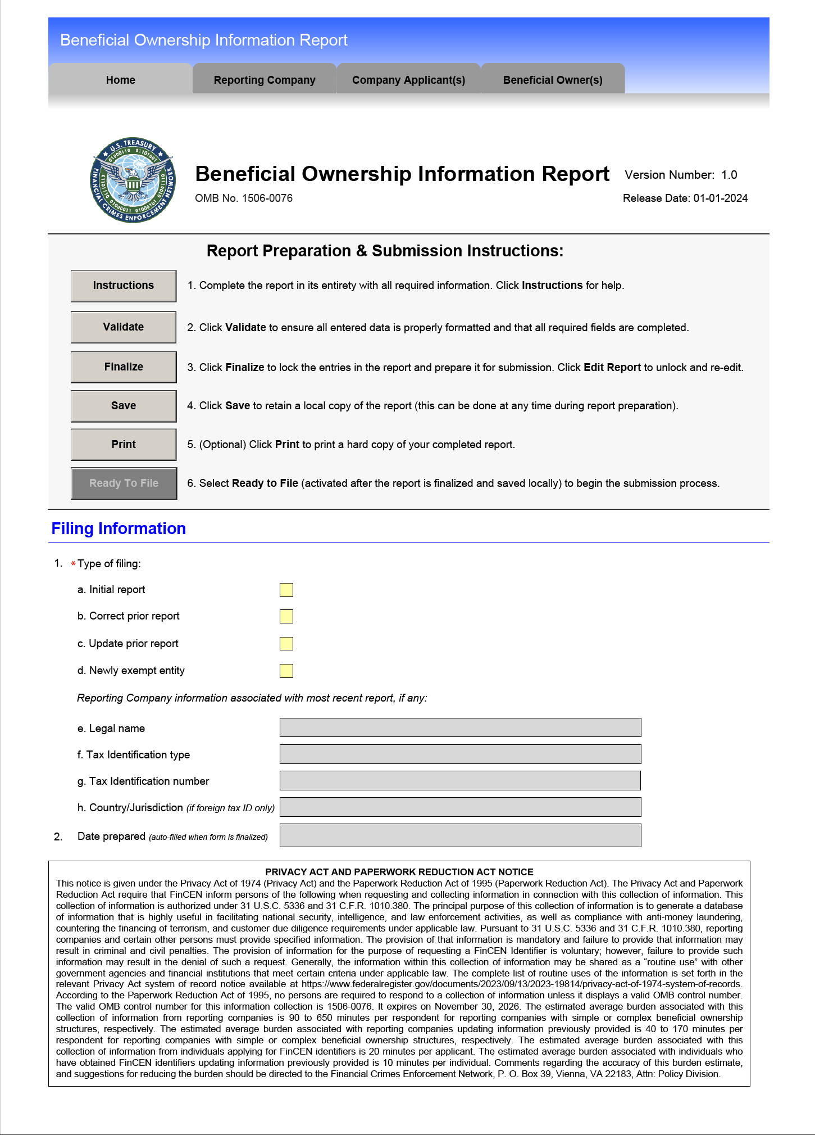
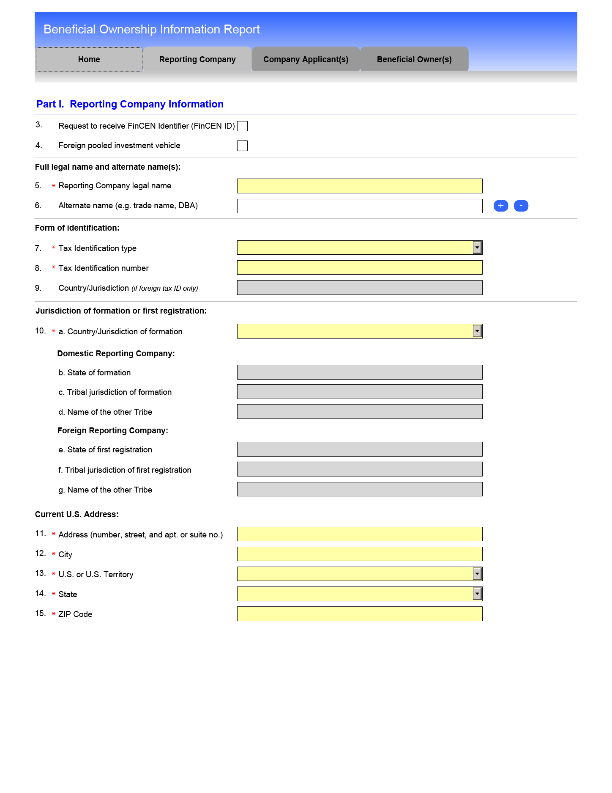
How do you file BOI?

Slide 17
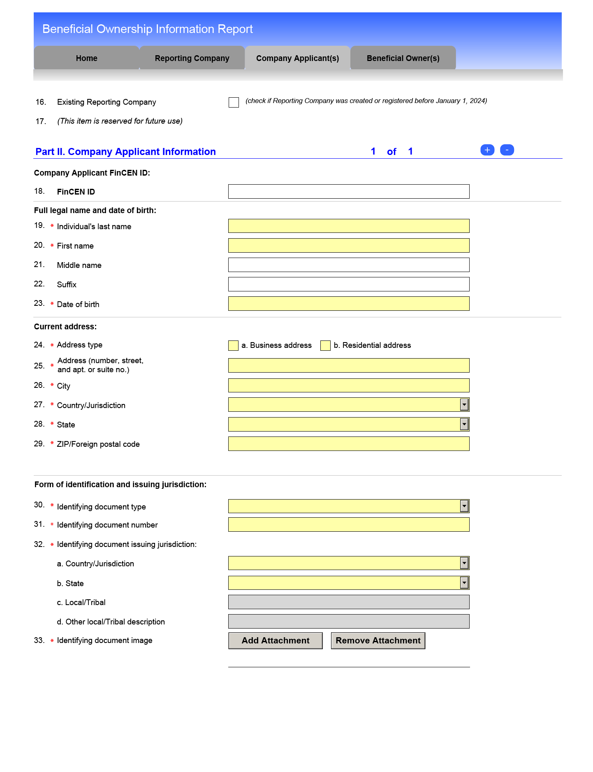
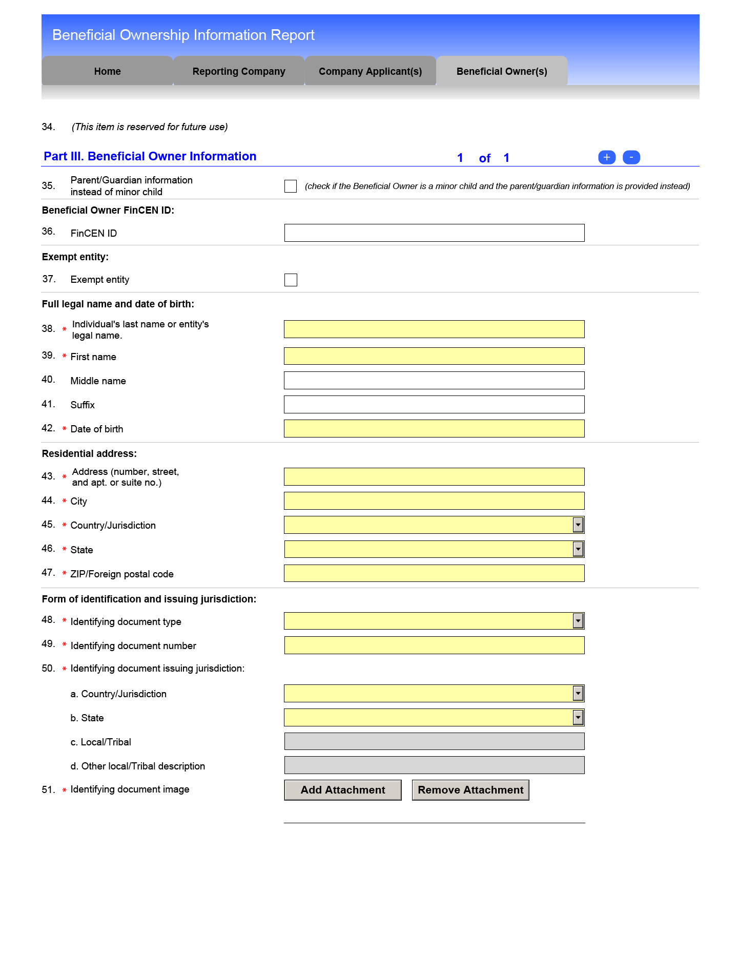
How do you file BOI?

Slide 18
Example 1
Salon with a 100% owner and $800k of revenue that has about 15 employees.
Required to file. 100% owner is likely the only person that is reported.

Slide 19
Example 2
Salon with three equal 33.3% owners and one salon manager who has access to the books and runs day to day operations. Salon has $3M of revenue and 50 employees.
Probably required to file, but would need to check the FTE count very carefully. They could easily be under 20 FTE.
All three owners would be required, and potentially the salon manager as well would be reported as beneficial owners.

Slide 20
Example 3
Salon with three equal 33.3% owners and one salon manager who has access to the books and runs day to day operations. Salon has $3M of revenue and 50 employees. Additionally the same owners own the building in a different entity.
All three owners would be required, and potentially the salon manager would be reported as beneficial owners.
All three owners would be reported a second time for the rental property entity.

Slide 21
Example 4
Salon with three equal 33.3% owners and one salon manager who has access to the books and runs day to day operations. Salon has $6M of revenue from two locations and 80 employees. Additionally the same owners own the two buildings in two different entities.
If more than 20 FTE then the salon is exempt. If less than 20 FTE all 3 owners plus potentially salon manager would be reported.
All three owners would be reported a second and third time for the rental property entity. Rental still required to file even if salon is exempt under large business exception.

Slide 22
Example 5
Salon with three equal 33.3% owners and one salon manager who has access to the books and runs day to day operations. Salon has five different locations in five different LLCs. Each LLC has $1.5M of revenue and 25 employees. Additionally the same owners own the five buildings each in a separate LLC.
Each salon is likely less than 20 FTE, so all three owners plus potentially salon manager would be reported five different times.
All three owners would be reported five more times for the rental property entities. 10 total filings, with 35 people reported.

Slide 23
Closing Thoughts
Vast majority of independent salons will be required to file
Generally speaking it will be easy to identify the beneficial owners of a simple salon structure
Initial report is due by 12-31-2024
Penalties are severe, so have a plan for filing in 2024
Have a plan for tracking changes in 2025

Slide 24
We Are Here To Help
BOI Services
$1,000 for filing the initial BOI report for each entity for B&B to prepare and file which is separate from the salon advisory membership. We will be doing this work in the summer of 2024.
Some type of monitoring / updating service will be available in 2025 so an entity could remain compliant with changes to BOI reports. Pricing TBD.
Self filing for no charge can be done yourself online through https://www.fincen.gov/boi the FinCEN Small Business Compliance Guide will help and can be found here https://www.fincen.gov/sites/default/files/shared/BOI_Small_Compliance_Guide.v1.1-FINAL.pdf
24

Slide 25
Questions & Answers
Chris Wittich, MBT, CPA cwittich@myboyum.com
Salon Team Lead
Tracy Stevens, CPA
tstevens@myboyum.com
Salon Team

