Slide 1
Year-End Tax Planning

Slide 2
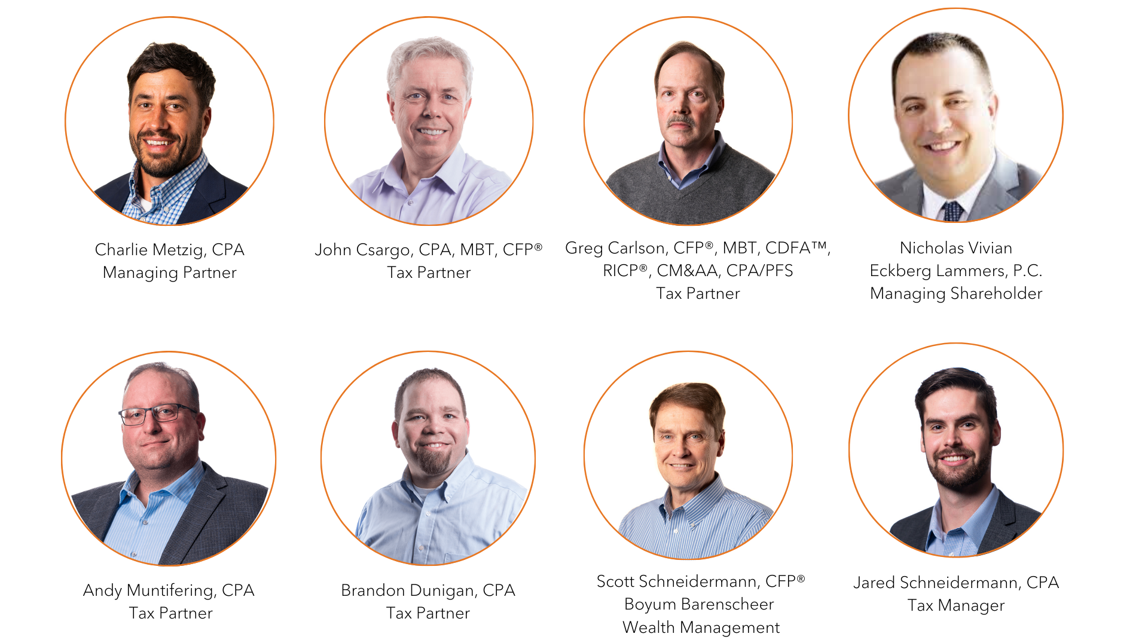

Slide 3
Agenda
Corporate Transparency Act
Secure Act 2.0
Inflation Reduction Act
Tax Cuts and Jobs Act (Sunset Provisions)
MN Omnibus Bill

Slide 4
Are You Prepared for the Requirements of the Corporate Transparency Act?

Slide 5
What is the Corporate Transparency Act?
The Corporate Transparency Act (“CTA”), enacted in 2021, was passed to enhance transparency in entity structures and ownership to combat money laundering, tax fraud, and other illicit activities. It is designed to capture more information about the ownership of specific entities operating in or accessing the U.S. market.
The effective date of the CTA is fast approaching on January 1, 2024, and business owners are starting to get nervous about its requirements.

Slide 6
What is the Corporate Transparency Act?
The CTA falls under the Anti-Money Laundering Act of 2022. It is administered by the Financial Crimes Enforcement Network (FinCEN), a part of the U.S. Treasury Department.
The CTA is designed to improve business activity transparency through the reporting of Beneficial Ownership and is targeted to smaller businesses.
The CTA contains three elements:
1. Who must file a Beneficial Ownership Report with FinCEN.
2. What information must be included.
3. When the report is due.

Slide 7
What is the Corporate Transparency Act?

Slide 8
What is the Corporate Transparency Act?
According to a recent Small Business Administration report, 27,104,006 small businesses were termed “nonemployer firms” and had no employees. The CTA is designed to improve business activity transparency through the reporting of Beneficial Ownership Information (BOI) and is particularly targeted to these smaller businesses.

Slide 9
Who Must File a Beneficial Ownership Report?
Reporting companies are identified as either domestic or foreign:
Domestic reporting companies are corporations, LLPs, or any other entity created by the filing of a document with a secretary of state or any similar office under the law of a state or Indian tribe.
Foreign reporting companies are a corporation, LLCs, or other entity formed under the law of a foreign country that is registered to do business in any state or tribal jurisdiction by the filing of a document with a secretary of state or any similar office. Sole-proprietorships that don’t use a single-member LLC are not considered a reporting company.
Reporting companies typically include:
Limited liability partnerships
Limited liability limited partnerships
Business trusts
Most limited partnerships, where entities are generally created by a filing with a secretary of state or similar office.
Exemptions include securities issuers, domestic governmental authorities, banks, and many more that don’t fall into the above categories.
It is also important to note that if your CPA or Attorney assisted in the setup of your Reporting Company, they will be required to file the same reports as well.

Slide 10
Who is a Beneficial Owner?
A Beneficial Owner can fall into one of two categories defined as any individual who, directly or indirectly, either:
1.Exercises substantial control over a reporting company, or
2.Owns or controls at least 25% of the ownership interests of a reporting company.
Having two categories is designed to close any loopholes and ensure all owners are identified. The key difference is that beneficial ownership is categorized as those with ownership interests reflected through capital and profit interests in the company.
The beneficial owners must report to FinCEN their name, date of birth, address, and unique identifier number from a recognized issuing jurisdiction and a photo of that document. If an individual decides to file their information to FinCEN directly, they may be issued a “FinCEN identifier” which can be provided on a BOI report instead of the required information.

Slide 11
What Information Must Be Provided by Beneficial Owners?
1.Name
2.Date of Birth
3.Address
4. Unique Identifier Number from a recognized issuing jurisdiction and a photo of that document.
Non-expired passports
Non-expired identification document issued by a State
Non-expired driver’s license

Slide 12
When Do Reports Need to Be Filed?
The CTA comes into effect on January 1, 2024. Reporting companies that are in existence on the effective date must file their initial reports within one year.
Reporting companies created after the effective date have 30 days after receiving notice of their creation or registration. However, FinCEN has proposed to extend the initial filing deadline for BOI reports from 30 to 90 days for entities created or registered in 2024.
Reports must be updated within 30 days of a change to the beneficial ownership, e.g., through the sale of a business, merger, acquisition, or death, or 30 days upon becoming aware of or having reason to know of inaccurate information previously filed.

Slide 13
What are the Penalties for Non-Compliance?
Non-compliance can result in high penalties and possible imprisonment. The escalating fines range from $500 to $10,000 per violation and jail time up to two years.
The American Bar Association points out that the fines accrue if initial reports are not filed and beneficial ownership changes.

Slide 14
What’s Next?
Know the Filing Requirements.
Contact your Attorney or CPA for assistance with filing and compliance.

Slide 15
Thank You
Nick Vivian
Eckberg Lammers, PC
715.808.8843
nvivian@eckberglammers.com

Slide 16
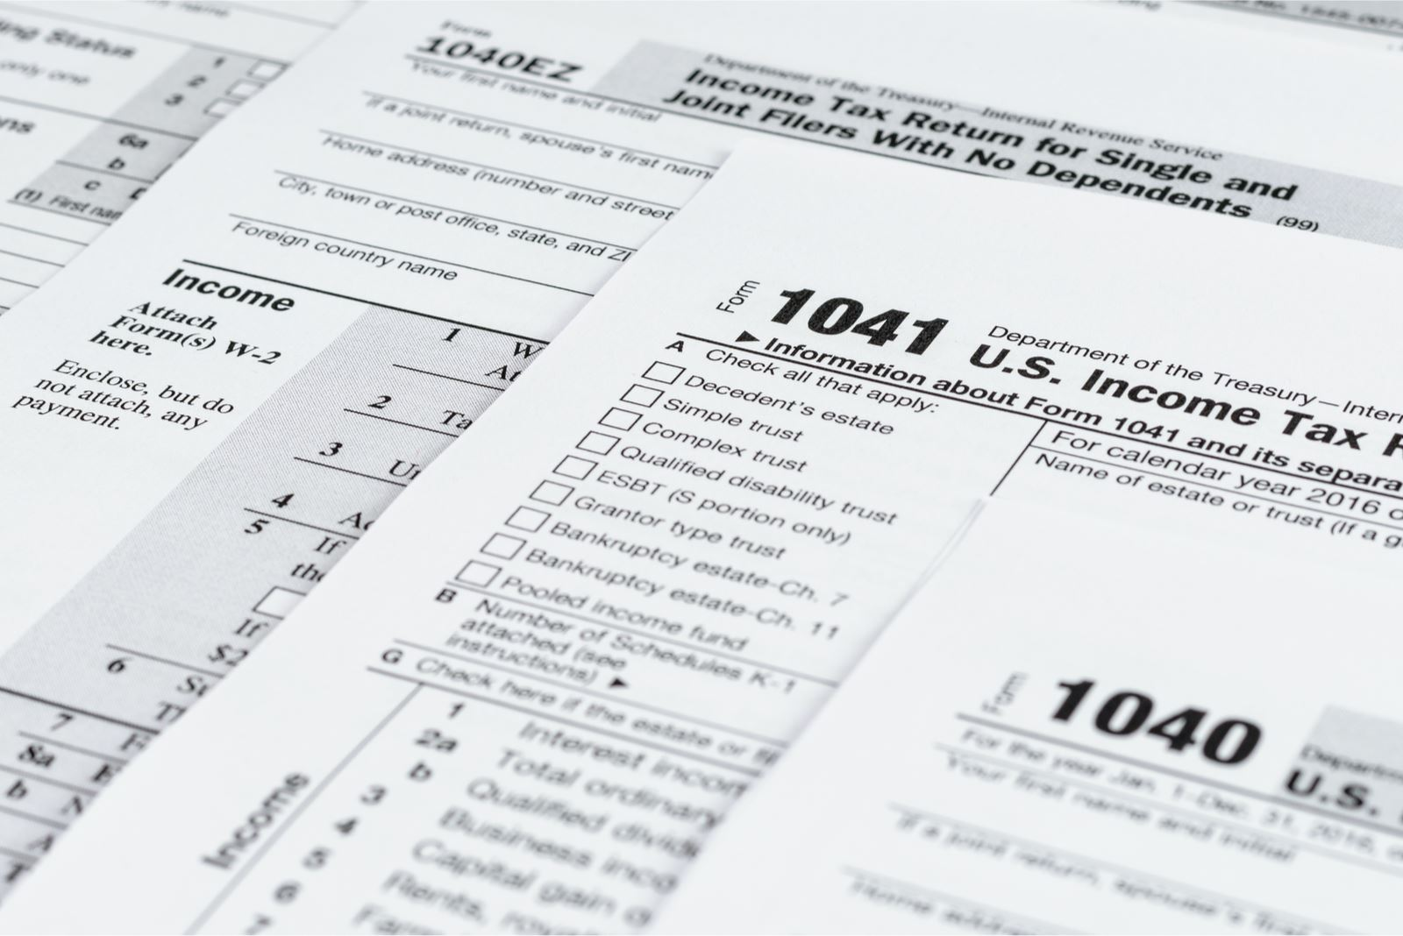
SECURE Act 2.0
Increases the age to begin required minimum distributions from 72 to age 73 in 2023, and age 75 in 2033
Attain age 72 after December 31, 2022 = age 73
Attain age 74 after December 31, 2032 = age 75
Requires elective deferral catch-up contributions to a qualified plan to be Roth contributions if prior year wages exceeded $145,000
Original effective date was for plan years beginning after 12-31-2023
Two-year extension was granted

Slide 17
SECURE Act 2.0 - Continued…
3. Section 529 plan rollovers
$35,000 lifetime limit starting in 2024
Must be trustee-to-trustee to a Roth. The 529 plan needs to be in existence for 15 years.
Rollover can’t exceed 529 contributions or earnings on contributions over 5 years old.
Example - contributed $5,000 in 2008, account balance at 12.31.18 is $6,000, contributed and $2,000 in 2020 and account balance prior to rollover in 2024 is $10,000. The rollover from 529 to Roth cannot exceed balance 5 years old at 12.31.18 of $6,000.
Subject to the annual Roth IRA contribution limits
4. Higher catch-up for ages 60 to 63
$10,000 or 50% more than the regular catch-up contribution limit
Starts in 2025

Slide 18
SECURE Act 2.0 - Continued…
5. SECURE Act 1.0
IRS proposed regulations state that if the original account owner died after their required beginning date, then the inherited IRA is subject to both the 10-year rule and the annual RMD rule
IRS Notice 2022-53 - No RMD required for 2021 or 2022
IRS Notice 2023-54 - No RMD required for 2023
Effective date of the RMD provision deferred until at least 2024

Slide 19
Inflation Reduction Act
Corporate Minimum Tax
15% tax based on financial statement income – effective for tax years beginning after December 31, 2022
Applies to C corporations with over $1 billion in income
Energy Credits
30% residential clean energy credit extended through 2032
$1,200 annual credit for energy efficient home improvements

Slide 20
Inflation Reduction Act – Continued …
3. Clean Vehicle Credits
a) Used Vehicle Credit
Nonrefundable credit
Adjusted gross income limitation ($150,000 for married joint)
Must meet requirements (model year, GVWR, etc.)
Vehicle costing $25,000 or less
Credit up to $4,000
Dealer must provide a seller report at time of sale with name and ID number
b) New Vehicle Credit
Nonrefundable credit
Adjusted gross income limit ($300,000 for married joint)
Must meet specifications (battery capacity, GVWR, etc.)
Vehicle costing $80,000 or less for vans, SUVs, and pickups; $55,000 or less for all other vehicles
Credit up to $7,500
Dealer must provide a seller report at time of sale with name and ID number

Slide 21
1099-K reporting update – 2023 to 2025
IRS Notice 2023-221 (November 21, 2023) delayed effective date and reporting requirements as follows:
For 2023 and prior years, payment apps and online marketplaces are only required to send out Forms 1099-K to taxpayers who receive over $20,000 and have over 200 transactions.
For tax year 2024, the IRS plans for a threshold of $5,000 to phase in reporting requirements.
For tax year 2025, the IRS plans for full implementation of the $600 threshold.

Slide 22
Tax Cuts and Jobs Act – Sunset Provisions
Estate Tax Provisions
Lifetime gift and estate exemption cut in half starting in 2026
GST exemption cut in half starting in 2026
Income Tax Provisions
Top individual rate back to 39.6% in 2026
Qualified business income deduction goes away after 2025
SALT limit (and Minnesota Pass-Through Entity tax deduction) ends after 2025
Individual exemptions return in 2026
Increased standard deduction goes away after 2025
AMT exemption will decrease in 2026
Bonus depreciation down to zero by 2027
Provisions that have already been implemented - starting in 2022
Capitalization of research and experimental expenditures – Section 174
Changes to computation of the business interest expense deduction – Section 163(j)

Slide 23
Minnesota Omnibus Tax Bill
One-time tax rebate checks
Update the Federal conformity date to May 1, 2023
Exempts Social Security benefits from taxation (adjusted gross income below $100,000 - married joint)
One-time special property tax refund (6% increase in property taxes year-over-year results in refund, rather than 12%)
Imposes a 1% net investment income tax on net investment income over $1 million (including estates and trusts)
Changes to pass-through entity tax
If a partnership has a disqualified partner, the remaining partners can still elect
For partnerships, income subject to the tax includes all income allocated to resident partners, not just apportioned income
For S corporations, income subject to the tax includes only apportioned income

Slide 24
IRS Provides Tax Inflation Adjustments for 2024
Marginal Rates
35% for incomes over $243,725 for Single ($487,450 for MFJ)
32% for incomes over $191,950 for Single ($383,900 for MFJ)
24% for incomes over $110,525 for Single ($201,050 for MFJ)
22% for incomes over $47,150 for Single ($94,300 for MFJ)
12% for incomes over $11,600 for Single ($23,200 for MFJ)
Standard Deduction
Single – rises to $14,600, an increase of $750 from 2023
Add $1,950 for if over age 65 or blind
Married Filing Jointly (MFJ) – rises to $29,900, an increase of $1,500 from 2023
Add $1,550 for each person over age 65 or blind (MFJ)

Slide 25
Retirement Plan Contribution Limits
401(k), 403(b) and most 457 plan contribution limits increased to $23,000, up $500 from 2023
Catch-up contributions for employees aged 50 and over remain at $7,500
SIMPLE contribution limit increased to $16,000, up $500 from 2023
Catch-up contributions for employees aged 50 and over remain at $3,500
IRA contributions increased to $7,000, up from $6,500
Catch-up contributions for persons aged 50 and over remain at $1,000

Slide 26
Gift and Estate Tax Indexing
Gift tax annual exclusion increases to $18,000 for 2024, an increase of $1,000 from 2023
Estate tax exclusion increased to $13,610,000 (was $12,920,000 in 2023)

Slide 27
Questions/Wrap Up

