Slide 1
Employee Retention Credit for Salons
Presented by
Chris Wittich, MBT, CPA

Slide 2
Disclaimers
The information contained herein should not be construed as legal, accounting, or tax advice. The commentaries provided are the opinions of Boyum Barenscheer PLLP and are for informational purposes only. While the information is deemed reliable, Boyum Barenscheer cannot guarantee its accuracy, completeness, or suitability for any purpose and makes no warranties with regard to the results to be obtained from its use, or whether any expressed course of events will actually occur. The user should contact his or her Boyum Barenscheer or other tax professional prior to taking any action to ensure the user's unique facts and circumstances are considered prior to making any decisions.

Slide 3
Agenda
Employee Retention Credit
ERC Misconceptions
Cash Planning
Closing Thoughts with Q&A

Slide 4
Employee Retention Credit
ERC rules for 2020 year
New rules allow you to do both PPP and do ERC retroactively to 2020
Qualifying business has gross receipts down 50% from prior year in a quarter OR if the business was shut down during a quarter by government order
Qualification determined quarter by quarter
Qualifying wages amount are $10k per year per employee
Credit amount calculated at 50%
Qualifying wages include healthcare costs
Same wages cannot be used for PPP forgiveness and the ERC, no double dip, extreme complexity in this calculation, use extreme caution

Slide 5
Employee Retention Credit
Gross receipts test is very black and white
Totally shutdown is very black and white
Partially shutdown by government order is gray area
Possible partial shutdown situations would include:
Space restrictions that limit the number of people that can be in the salon at once and have an impact on your ability to do business
Being unable to double book clients
Unable to do certain service offerings like facials or massage

Slide 6
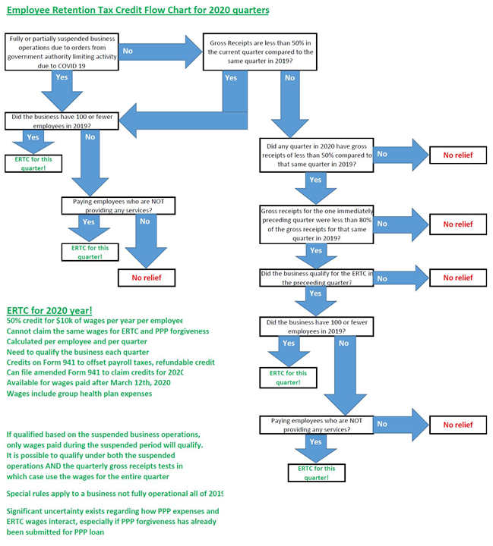

Slide 7
Employee Retention Credit
2020 example 1
Salon closed March 15 through April 15 by local order. Reopened with modifications, new procedures and Q2 gross receipts were 65% of the Q2 gross receipts in 2019. Q3 and Q4 of 2020 were 80% gross receipts of 2019.
Qualifies for ERC March 15th through March 30th
Qualifies for ERC April 1 through April 15th
Does not qualify for ERC the remainder of Q2
Need to look at the partially suspended business operations from local rules to determine further qualification

Slide 8
Employee Retention Credit
2020 example 2
Salon closed March 15 through April 15 by local order. Reopened with modifications, new procedures and Q2 gross receipts were 45% of the Q2 gross receipts in 2019. Q3 was 75% and Q4 was 105% gross receipts of 2019.
Qualifies for ERC March 15th through March 30th
Qualifies for ERC all of Q2 based on gross receipts being less than 50%
Qualifies for ERC all of Q3 based on less than 80% and Q2 qualifying
Qualifies for ERC all of Q4 based on Q3 qualifying and being less than 80%
Do not need to consider partial suspension because the gross receipts test is met to qualify for all of 2020

Slide 9
Employee Retention Credit
ERC rules that apply for 2021
New rules allow you to do both PPP Second Draw and do ERC in 2021
Qualifying business has gross receipts down 20% from prior year in a quarter OR if the business was partially shut down by government order
Qualifying wages amount expanded to be $10k per quarter per employee instead of the original $10k per year per employee
Employer can be up to 500 FTE in 2019 and qualify for 2021
Credit amount calculated at 70% up from the original 50%
Qualifying wages include healthcare costs

Slide 10
Employee Retention Credit
ERC rules that apply for 2021
Same wages cannot be used for PPP forgiveness and the ERC, no double dipping
The normal ERC is available for the first 3 quarters in 2021
For any startup businesses that began in 2020 or 2021 you can look at the startup ERC rules and could be eligible for Q3 and Q4 of 2021

Slide 11
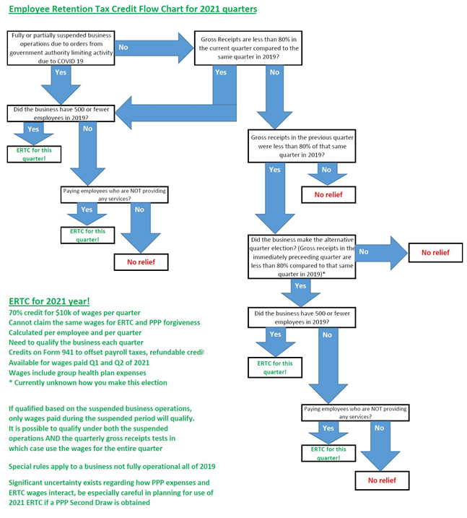

Slide 12
Employee Retention Credit
2021 example 1
Salon experiencing restrictions based on local shutdown orders January 1 through February 15. Business has 75% gross receipts Q1 compared to Q1 of 2019. Business has 90% gross receipts Q2 compared to 2019.
Qualifies for ERC January 1st through February 15th based on partially suspended business operations before they were lifted
Qualifies for ERC all of Q1 based on gross receipts being less than 80%
Qualifies for ERC all of Q2 because prior quarter election applies

Slide 13
Employee Retention Credit
Salon with 10 total employees in a red state
PPP1 $60k
PPP2 $60k
ERC $47k – about 78% of the PPP amount
ERC was $47k for 2020 year
Qualified with partial restrictions into September 2020

Slide 14
Employee Retention Credit
Salon with 20 total employees in a blue state
PPP1 $123k
PPP2 $123k
ERC $131k – about 106% of PPP amount
ERC was $75k for 2020 year plus $56k for Q1 2021, none Q2 2021
Qualified with partial restrictions into May 2021 (but the Q2 wages needed to be used for PPP so no credit generated)

Slide 15
Employee Retention Credit
Salon with 60 total employees in a red state
PPP1 $385k
PPP2 none
ERC $205k – about 53% of the PPP amount
ERC was $205k for 2020 year because they used nonpayroll costs on the PPP1 forgiveness application. If they had not used nonpayroll costs it would have reduced the ERC by $60k
Qualified based on partial restrictions into September 2020

Slide 16
Employee Retention Credit
Salon with 30 total employees in a blue state
PPP1 $135k
PPP2 none
ERC $261k – about 193% of the PPP amount
Qualified based on partial restrictions into May 2021. In this case did not have PPP2 which probably resulted in a bit more ERC than if they did get a PPP2

Slide 17
Employee Retention Credit
Salon with 50 total employees in a red state
PPP1 $400k
PPP2 $400k
ERC $816k – about 204% of the PPP amount
Qualified based on partial restrictions into May 2021. Qualified on gross receipts in Q2 2021 which means Q3 2021 as well.

Slide 18
Employee Retention Credit
Salon with 170 total employees in a blue state
PPP1 $1M
PPP2 $1M
ERC $2.5M – about 250% of the PPP amount
Qualified based on partial restrictions into May 2021. Qualified on gross receipts in Q2 2021 which means Q3 2021 as well.

Slide 19
Employee Retention Credit
Rule of thumb based on 275+ salon ERC projects we’ve done totaling $50M+ of credits
Blue State – outcomes typically range between 125% and 200% of PPP loan amount
Red State – outcomes typically range between 50% and 125% of PPP loan amount
PPP forgiveness nonpayroll cost and timing of PPP2 loan are key factors

Slide 20
Employee Retention Credit
Do the calculation of qualifying wages for ERC by period
Employee by employee
Quarter by quarter based on qualifications
No overlapping the PPP forgiveness
No overlapping with sick leave credits
Picking and choosing between ERC and PPP
File amended 941 payroll tax return for affected quarters
Get a check in the mail from the IRS – when?
The money is taxable for the business – amend income tax returns

Slide 21
ERC Misconceptions
I should get $26,000 for every employee
I used my PPP money on wages so I cannot claim ERC
I cannot get ERC in 2021 because I got PPP2
I cannot qualify for ERC because my revenue was flat or went up
My payroll company can calculate it for me
A friend of mine got way more or way less, mine must be wrong
I need to file this before the money runs out
I already filed for this before I can’t do it again
I don’t need the money now

Slide 22
ERC Misconceptions
I should get $26,000 for every employee FALSE
There are lots of ERC mills that are currently marketing to companies claiming you qualify for $26,000 for every single employee. While in theory that could be true, in reality I have never once seen a business qualify for that much. You need to have a reason to qualify for all of 2020 + 3 quarters in 2021. There are limitations based on double dipping with PPP money, not all employees will make enough to get the maximum anyways. Just too many hurdles to think you could possibly get $26,000 per employee.

Slide 23
ERC Misconceptions
2. I used my PPP money on wages so I cannot claim ERC FALSE
No double dipping is allowed, but ERC calculations are flexible and can allocate PPP forgiveness in the most advantageous way possible, picking and choosing can still result in qualifying for ERC
How you filled out PPP1 and PPP2 forgiveness will play a major role in determining how much ERC you qualify for, not if you will qualify, but how much

Slide 24
ERC Misconceptions
3. I cannot get ERC in 2021 because I got PPP2 FALSE
The same rules around no double dipping apply in 2020 and 2021, but you can still have both in 2021, the ERC calculations are flexible and can allocate PPP forgiveness in the most advantageous way possible
How you fill out PPP2 forgiveness will play a major role in determining how much ERC you qualify for

Slide 25
ERC Misconceptions
4. I cannot qualify for ERC because my revenue was flat or went up FALSE
If you qualify based on the partial restrictions it does not matter how high or low your gross receipts are. Many salons got back to even or increased revenue despite dealing with restrictions on the business like capacity, or spacing, or limits on services, double booking prohibitions. When you change your hours of operations, hire new stylists, increase prices those things can help increase revenue despite the restrictions having a big impact on your business.

Slide 26
ERC Misconceptions
5. My payroll company can calculate it for me FALSE
Payroll companies are offering to do ERC for clients, but they are doing it incorrectly most of the time. The payroll company is not determining the qualifying period they are asking you the salon owner if you qualify or not. The payroll company is not determining which employees qualify they are asking you the salon owner which ones qualify. The payroll company is not calculating the tainted PPP forgiveness they are assuming that you the salon owner have done that yourself. Using a payroll company = getting the wrong answer, either way too much, or way too little.

Slide 27
ERC Misconceptions
6. A friend of mine got way more or less mine must be wrong FALSE
ERC is the most complicated thing I’ve encountered in 15 years of practice. Outcomes very dramatically based on how many employees you have, how you filled out PPP1 forgiveness, the dates of local restrictions, how you filled out PPP2 forgiveness, the number of family members employed within the business, the number of shareholders in the business, and the skill and knowledge of the person doing the calculations.

Slide 28
ERC Misconceptions
7. I need to file this before the money runs out FALSE
You have 3 years to file an amended 941 and claim the ERC. The 2020 ERC statute of limitations runs out in April 2024. The 2021 ERC statute of limitations runs out in April 2025. The sooner you file it the sooner you will get your refund, but it is not possible for the money to run out.

Slide 29
ERC Misconceptions
8. I already filed for this I can’t do it again FALSE
You claim ERC on an amended 941. If you made a mistake on the first amended 941 you filed, you can amend the amended 941 to fix it. If a quarter was done already and filed and it’s correct, that’s great, you can still calculate and then amend other quarters if ERC was missed.

Slide 30
ERC Misconceptions
9. I don’t need the money now Not Applicable
There is no part of qualifying for ERC that requires you demonstrate a need for the money. PPP required some current hardship or uncertainty, ERC does not. It’s like when you file a 1040 you don’t need to prove you need the child tax credit, if you have a dependent child and you meet the qualifications then you get the child tax credit whether you “need” it or not.

Slide 31
Cash Planning
Set aside money to pay your 2020 tax liability from 2020 ERC claim
Set aside money to pay your 2021 tax liability from 2021 ERC claim
Tax Planning for 2023 based on normal 2023 operations – consider bonuses to employees, consider build out expenses, consider equipment or education purchases
Determine future cash needs of the business – expansion, renovations, new shareholders, big expenses coming up in the next 6-12 months and how that will impact cash
Determine the “normal” operating cash reserves

Slide 32
Cash Planning
Distribute or spend the excess cash on the owners
Company retirement plan contributions
Personal savings account
Payoff personal high interest debt – CC, student loans, car loans, etc
Personal retirement plan contributions
Personal 529 plan contributions
Charitable contribution planning
Personal taxable investment account
Get cash down to “normal” once ERC cash received
7. Setup a plan for a more normal 2023
Owner wage and distribution strategy for 2023

Slide 33
Cash Planning
Monitor future tax legislation
Tax bills that might happen in 2023 – potential to change tax rates, change the itemized deduction rules, change bonus depreciation rules
State specific rules – pass through entity tax rules are coming in for many states in 2022 and in 2023
State tax changes whether conformity with federal tax law changes
Check back for more webinars and more advice
9. Understand the business of your business, look at it every month

Slide 34
Closing Thoughts
Calculate ERC both for 2020 and 2021 based on partial restrictions and gross receipts. This is the craziest thing I’ve ever seen, and I’m confident it will be the craziest thing in my career. Don’t miss out on exploring it.
Set yourself up for new normal in 2023 – have a strategy for both owner compensation and distributions and what to do with ERC cash once received
Look at your financial situation every month, plan for future cash needs, plan for ERC tax liabilities, make informed decisions about where you spend money in the business

Slide 35
We Are Here To Help
ERC Consulting Services
ERC calculations – evaluating your eligibility and then calculating your ERC for 2020 and 2021
Our fees are based on how many qualifying employees you have and whether or not you have the PPP forgiveness overlapping the ERC
Our fees are capped at 10% of the credit amount, sometimes it works out to be less, sometimes it works out to be 10%
We have helped 275+ salons across the US calculate and then submit their ERC claims, totaling $50M+ of credits
Our ERC team has in total worked on more than 550 projects totaling $175M of credits across all industries
ERC@myboyum.com is the contact
35

Slide 36
Questions & Answers
Chris Wittich, MBT, CPA cwittich@myboyum.com
Salon Team Lead, ERC Team Lead
Becky Casalenda, CPA
bcasalenda@myboyum.com
Salon Team
Tracy Stevens, CPA
tstevens@myboyum.com
Salon Team

